Slide 1
Middleware Technologies for Systems Integration
SE495: Software and Systems Integration

Slide 2
Outline
Introduction to middleware
Message-oriented middleware (MOM)
Enterprise service bus (ESB)
Integration platform as a service (iPaaS)
Comparison and Use cases

Slide 3
Introduction to middleware

Slide 4
Middleware
Middleware is a software layer that provides a bridge between different applications or systems, allowing them to communicate and interact with each other.
It sits between the operating system and the application layer, and provides a set of common services and functions that can be used by applications across different platforms and environments.
Middleware can also provide additional features such as:
message queuing
data transformation, and
security, which can help simplify and streamline application development and integration.

Slide 5
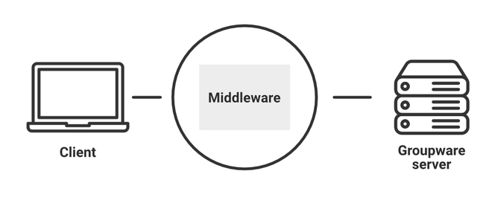
Middleware
The goal of middleware is to abstract the underlying complexity of different systems and provide a standardized way for them to communicate and share data.
This can help improve system interoperability, reduce development time and costs, and enhance overall system performance and reliability.
Middleware can be used in a wide range of applications, including:
enterprise systems,
web applications,
mobile applications, and more.

Slide 6
Overview of middleware technologies
Middleware technologies are a set of software tools and platforms that are used to facilitate communication and integration between different systems and applications.
Here's an overview of some common middleware technologies used for systems integration:
Message-oriented middleware (MOM):
Message-oriented middleware is a type of middleware that allows applications to exchange asynchronous messages. MOM provides a messaging infrastructure that can handle message queuing, routing, and delivery, and can help decouple applications and systems from each other. MOM is commonly used in enterprise systems for integrating disparate applications and systems.

Slide 7
Overview of middleware technologies
Distributed Object Computing (DOC):
Distributed Object Computing is a middleware technology that allows objects to communicate and interact with each other across different systems and platforms. DOC provides a set of services and protocols for object communication, such as Remote Procedure Call (RPC) and Common Object Request Broker Architecture (CORBA). DOC is commonly used in enterprise systems for integrating legacy systems and applications.
Enterprise Service Bus (ESB):
An Enterprise Service Bus is a software platform that allows applications to communicate and interact with each other using a service-oriented architecture (SOA). An ESB provides a set of services and functions, such as message routing, transformation, and security, which can be used to integrate applications and systems. ESBs are commonly used in modern enterprise systems for integrating cloud-based and on-premises applications.

Slide 8
Overview of middleware technologies
API Management Platforms:
API management platforms are a type of middleware technology that provides a set of tools and services for managing APIs. API management platforms can provide features such as API gateways, security, analytics, and developer portals, which can help organizations manage and secure their APIs, monitor API performance, and promote API adoption and usage.
Data Integration Platforms:
Data integration platforms are a type of middleware technology that provides a set of tools and services for integrating data from different sources and systems. Data integration platforms can provide features such as data mapping, transformation, and synchronization, which can help organizations consolidate and analyze data from disparate systems and applications.

Slide 9
Challenges
Integrating disparate systems and applications can be a complex and challenging process that requires significant time and resources.
Middleware technologies can help address these challenges by providing a standardized way for systems and applications to communicate and share data.
Here's an explanation of how middleware technologies can help integrate disparate systems and applications, and how they can address the challenges associated with systems integration:
Standardized Communication Protocol
Data Transformation
Message Queuing
Security
Scalability
Decoupling

Slide 10
Message-oriented middleware (MOM)

Slide 11
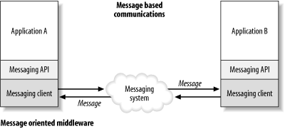
Message-Oriented Middleware (MOM)
Message-oriented middleware (MOM) is a type of middleware that allows applications to exchange asynchronous messages.
MOM provides a messaging infrastructure that can handle:
message queuing,
routing, and delivery, and
can help decouple applications and systems from each other.

Slide 12
Message-Oriented Middleware (MOM)
In a MOM architecture, applications send and receive messages through a message broker, which acts as an intermediary between the sender and the receiver.
The message broker can handle message queuing, routing, and delivery, and can ensure that messages are delivered in the correct order and that they are not lost in transit.
MOM can be used in a wide range of applications, including
distributed systems,
enterprise systems, and
service-oriented architectures (SOAs).

Slide 13
Message-Oriented Middleware (MOM)
This type of middleware is an infrastructure that supports the receiving and sending of messages over distributed applications.
It enables applications to be disbursed over various platforms and makes the process of creating software applications spanning many operating systems and network protocols much less complicated.
It holds many advantages over middleware alternatives (e.g. hard coding logic) and is one of the most widely used types of middleware.
Examples:
TIBCO TIB/Rendezvous, BEA MessageQ, Microsoft MSMQ, ActiveWorks

Slide 14
Features of message-oriented middleware
Asynchronous messaging
Assured message delivery
Routing
Transformation
Transaction support
Notification services
Additional features such as
provisioning and monitoring,
unified messaging,
dynamic scaling, secure communication, management and control tools, flexible service quality, and interaction with other devices.

Slide 15
Roles of message-oriented middleware
The message distribution is enabled over complex IT systems.
It servers as a connector for two different applications or platforms.
MOM helps in implementing the delivery of messages across different IT organizations.
It will create a distributed product that is compatible with the various OS.
MOM allows various software components can talk to each other.
It is a type of middleware that consists of several lines that are connected to different applications.
It connects different technologies involving message origination and delivery destination.
It links front and back-end systems.

Slide 16
Advantages of message-oriented middleware
Simple and convenient
Streamlines business operations
Adaptable
Developer-friendly
Time and location-independent
Wide range of software systems
Event-driven system support
Scalability

Slide 17
disadvantages of message-oriented middleware
MOMs require an additional architectural element. .
The existence of a message transfer agent or broker is one of the main cons of message-oriented middleware. A system's performance can decrease due to the addition of components, thereby increasing maintenance costs and complexity.
MOMs have high development costs.
Not many organizations can afford to operate a message-oriented middleware system due to high development costs.
MOMs need improvement.
Many MOM systems are still not wholly designed for optimal operations, which can threaten a system's real-time performance in some conditions.

Slide 18
Enterprise service bus (ESB)

Slide 19
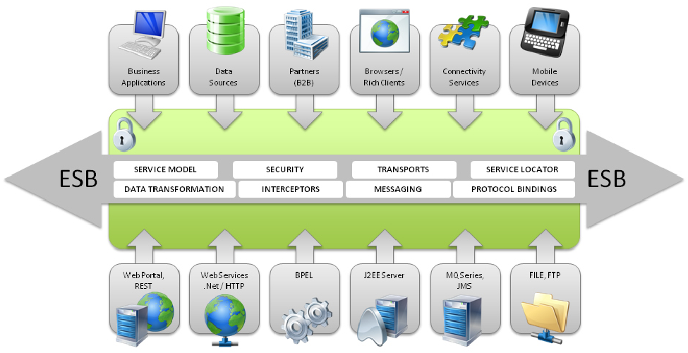
ESB
An enterprise service bus (ESB) is a software platform that facilitates the exchange of messages between different applications and systems.
ESBs provide a number of features that make it easier to integrate applications, including:
Routing
Transformation
Security
Monitoring
ESBs are a valuable tool for integrating applications.
They can help to improve performance, reliability, flexibility, and security.

Slide 20
Enterprise Service Bus (ESB)
Shifting from Distributed Object Orientation to Service Orientation
An ESB provides an abstraction layer on top of an implementation of an enterprise messaging system;
It allows integration architects to exploit the value of messaging without writing code.
It is the service-oriented version of ORB.
Contrary to the more classical Enterprise Application Integration (EAI) approach (tightly coupled), ESB provides a loosely coupled platform to support distributed functions, with distributed (independent) deployment where needed, while still working in harmony.

Slide 21
Enterprise Service Bus (ESB)
An enterprise service bus (ESB) implements a communication system between mutually interacting software applications in a service-oriented architecture (SOA).
ESB promotes agility and flexibility with regard to high-level protocol communication between applications.
Its primary use is in enterprise application integration (EAI) of heterogeneous and complex service landscapes.

Slide 22
Modeling Business in SOA
Turn this model …
…into this (SOA).
Depository
Vendor Setup
Vendor
Process Servers
Banks
Customer Perceived
Application
Service
Application
Service
Application
Service
Application
Service
Budget
Maintenance
(Imaging)
NEW Soundscan
Shows
VAN
Universal Account
In-Stock
Analysis Tool
Printer
S20-Sales
Mesa Data
Reconcilliation
Maintenance
Polling
I13- Auto
Hand Scan
Printer PO
Customer
Replenishment
Apps
Reports
Insertions
Sales
Order
Due Dates
Calendar
Orders
Print Costing
Corrections
Warehouse
Broadcast
General
Invoice App
Management
Stores & Mrkts
Filter
Maintenance
Interface
PO
Smart Plus
Millennuim 3.0
Smart Plus
Sales Posting
Launcher
Cell
Return to
Tally Sheet
Millennium
Phones
D01 Post Load
Vendor
Credit App
Stock Options
Employee
Equifax
Billing
Solution
Satellite
Resource
Change Notice
A04 - Cust
Software
System
-Promo
Scheduling
On-line New
Refund Chks
DFK
1
Analysis
Interface
Interface
Interface
Resumix
Hire Entry
P01-
AAS
Price
Employee
Marketing
Cobra
P09 - P17
Masterfile
Support
Bus Systems
Cyb.
ABC
website
- ISP
CTS
Co
Home
Cycle Physical
Tracking
ACH
Prodigy
V04-Sign
Deliveries
Inventory
Banks - ACH and Pos to
POS
System
CTO
-
Pay
Transfers
Host to AS400
Plan Administrators
Communication
(401K, PCS, Life)
Spec Source
Stock
SKU Tracking
Status
Counts
Price
Testing
Supplier
Employee
Intercept
Sales
Scanning
Layaways
Compliance
Purchase
Tax
Spec
PO
Scorecard
Source
Receiving
SKU
Mkt
Performance
Bonus/HR
Reactions
Polling
Price Management
Inventory Info
Coop
SKU Selection
DRK
System
Customer Repair
Tool
ABBX
Tracking
I35 Early Warning
Planning
Rebate
SKU Rep
System
Store
Transfer
SKU
Purchase
Monitor
PowerSuite
General
Information
Order
Ad Expense
Ledger
Store
Tex A
Sign
Scorecard
System
N.
Count Corrections
Store Budget
Interface
Interface
Interface
Interface
Tx
Writer
Merchandise
Media
Reporting
Workspace
Analysis
BMP - Bus
EDI
performance Mngt
Mngr Approval
Coordinator
Batch Forcasting
AIMS
AP
Journal Entry Tool Kit
Ad Measurement
Cellular
INVENTORY CONTROL APPS - PC
INVENTORY CONTROL APPS - PC
ACCTS REC APPS - PC
Ad
AIMS
Rollover
OTHER APPS - PC
Launcher
Reporting
House
PSP
Capital
Op.
Recon
File
Charges
Data Warehouse
In-Home
Projects
SS
Connect 3
Credit
Repair
Connect 3
Connect 3
Cash Receipts/Credit
Application
Service
Application
Service
Application
Service
Application
Service
Fixed
PDF Transfe
Reports
Misc Accounting/Finance Apps - PC/NT
Warranty
Assets
Billing
Repair
Cash Over/
System
Short
Rich business abstractions describe the application interface
Decouples the interfaces from the business applications
The number and complexity of the interfaces are reduced
Business applications and their interfaces become reusable
Notes:
So how does web services decouple the interfaces from their applications?
1) It uses a programming model that allows a rich abstraction of both the business app and the interface.
2) By abstracting the interfaces, they can be clearly separated from the business applications.
3) This enables you to reduce the number and complexity of those interfaces and.
4) It allows you to reuse both the interfaces and the business applications.
The problem is that you still have to build, find, and manage all of those interfaces somewhere.

Slide 23
The ESB shrinks those interfaces further
Turn this (web services)…
…into this (SOA)
Application
Service
Application
Service
Application
Service
Application
Service
Application
Service
Application
Service
Application
Service
Application
Service
Interface
Interface
Interface
Enterprise Service Bus
Interface
Interface
Interface
Interface
Application
Service
Application
Service
Application
Service
Application
Service
Application
Service
Application
Service
Application
Service
Application
Service
Decouples the point-to-point connections from the interfaces
Allows for dynamic selection, substitution, and matching
Enables more flexible coupling and decoupling of the applications
Enables you to find both the applications and the interfaces for re-use
Notes:
The ESB shrinks the interfaces further.
1) It virtualizes the interface, or in other words, it decouples the point-to-point connections from the interfaces themselves.
2) The interfaces are put into a third party broker which helps you manage the interfaces better.
3) The enables faster and more flexible coupling and decoupling of applications.
4) Because you can find all of the applications and the interfaces, you can then reuse both.

Slide 24
ESB Components
An ESB architecture typically includes several components, such as:
Message bus:
The message bus is the backbone of the ESB architecture and acts as a central hub for exchanging messages between different applications and systems.
Service registry:
The service registry is a central repository that stores information about the services available on the ESB platform, including their location, version, and capabilities.
Message router:
The message router is responsible for routing messages between different applications and systems based on predefined rules and criteria.

Slide 25
ESB Components
An ESB architecture typically includes several components, such as:
Message transformer:
The message transformer is responsible for transforming messages between different data formats, making it possible for applications and systems to communicate with each other.
Security gateway:
The security gateway is responsible for enforcing security policies and ensuring that messages are secure and protected from unauthorized access.

Slide 26
Benefits to organizations
Improved system interoperability:
ESBs can help integrate disparate applications and systems by providing a standardized way for them to communicate and share data.
Reduced development time and costs:
ESBs can simplify the process of systems integration, reducing development time and costs.
Increased system reliability and availability:
ESBs can improve system reliability and availability by providing a centralized platform for managing and monitoring message exchange between different applications and systems.
Enhanced scalability:
ESBs can help optimize system performance and scalability by providing a flexible messaging infrastructure that can handle large volumes of data and transactions.
Improved system agility:
ESBs can help organizations respond quickly to changing business requirements by providing a flexible and adaptable messaging infrastructure that can be modified or extended as needed.

Slide 27
ESB Examples
MuleSoft Anypoint Platform
Apache ServiceMix, and
IBM Integration Bus
ESBs can be used in a wide range of applications, including
enterprise systems,
financial systems,
supply chain management systems, and more.

Slide 28
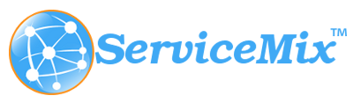
Apache ServiceMix
Apache ServiceMix is an open-source Enterprise Service Bus (ESB) platform that provides a flexible and scalable messaging infrastructure for integrating disparate systems and applications.
ServiceMix is built on top of the Apache Karaf container, which provides a lightweight and modular framework for deploying and managing OSGi-based applications.
ServiceMix provides a wide range of features and services for enterprise integration, including:
Message routing and transformation
Service registry and discovery
Message queuing and delivery
Security and authentication:

Slide 29
Apache ServiceMix
Support for multiple protocols and standards:
ServiceMix supports a wide range of protocols and standards, including HTTP, SOAP, REST, JMS, and more.
Pros:
Open source, Flexible and modular architecture, Wide range of supported protocols and standards, Scalable and reliable, and Comprehensive security features
Cons:
Steep learning curve, Limited documentation, Requires technical expertise, Limited community support, and Limited out-of-the-box functionality

Slide 30
Integration platform as a service (iPaaS)

Slide 31
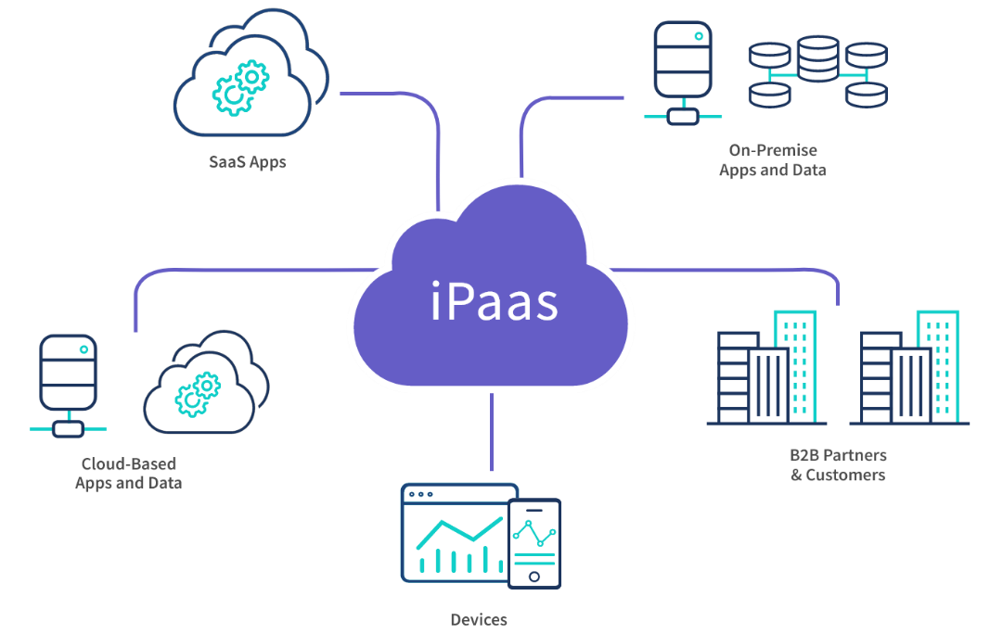
Integration platform as a service (iPaaS)
An iPaaS, or integration Platform as a Service, is a platform that standardizes how applications are integrated into an organization, making it easier to automate business processes and share data across applications.

Slide 32
Integration platform as a service (iPaaS)
iPaaS is a cloud-based integration platform that provides a set of tools and services for integrating applications and systems in the cloud.
iPaaS platforms typically provide a web-based interface for designing, deploying, and managing integrations, and can handle a wide range of integration scenarios, including cloud-to-cloud, cloud-to-on-premises, and on-premises-to-on-premises integrations.

Slide 33
Common Features of iPaaS Solutions
Guaranteed data delivery
The ability to hold data until it has safely reached its destination
Error handling
The ability to indicate where errors occur in the transfer of data
Endpoint connectors
iPaaS solutions typically make it easier to connect with specific applications without needing to code directly via API; this includes connectors for specific applications, as well as for universal communication protocols, such as FTP/SFTP; HTTP/S, OFTP, OFTP2; XML standards; as well as EDI, EDIFACT, SWIFT, and many others

Slide 34
Common Features of iPaaS Solutions
Data governance
Enables only users who are granted specific permission to access data
Lifecycle management
A centralized console for use in creating, managing, and governing integrations; develop integration flows that automate the exchange of data between disparate applications, siloed data sources, and trading partners
Developer tools
Developer tools enabling deep customization and complexity when building integration flows

Slide 35
Advantages of iPaaS
Accessibility
Connectivity
Constant updates
Integration
Agility
Access to information in real time between systems

Slide 36
Disadvantages of iPaaS
Limited customization
Network latency
Data privacy concerns
Vendor lock-in

Slide 37
Examples
Dell Boomi:
Dell Boomi is a cloud-based iPaaS platform that provides a set of tools and services for integrating applications and systems in the cloud.
Boomi provides a range of features, including data mapping and transformation, connectors and adapters, message routing and delivery, API management, and integration monitoring and reporting.
IBM Cloud Pak for Integration:
IBM Cloud Pak for Integration is a cloud-based iPaaS platform that provides a set of tools and services for integrating applications and systems in the cloud.
Cloud Pak for Integration provides a range of features, including data mapping and transformation, connectors and adapters, message routing and delivery, API management, and integration monitoring and reporting.

Slide 38
Examples
Jitterbit:
Jitterbit is a cloud-based iPaaS platform that provides a set of tools and services for integrating applications and systems in the cloud.
Jitterbit provides a range of features, including data mapping and transformation, connectors and adapters, message routing and delivery, API management, and integration monitoring and reporting.
SnapLogic:
SnapLogic is a cloud-based iPaaS platform that provides a set of tools and services for integrating applications and systems in the cloud.
SnapLogic provides a range of features, including data mapping and transformation, connectors and adapters, message routing and delivery, API management, and integration monitoring and reporting.

Slide 39
Comparison and Use cases

Slide 40
Comparison
Criteria | Message-Oriented Middleware (MOM) | Enterprise Service Bus (ESB) | Integration Platform as a Service (iPaaS)
Definition | Middleware technology that sends and receives messages between distributed systems | Middleware technology that provides a messaging infrastructure and supports multiple communication protocols | Cloud-based integration platform that provides tools and services for integrating applications and systems
Features and Capabilities | Asynchronous messaging, message queuing, publish/subscribe messaging, messaging transformation | Message routing, message transformation, service registry, security and authentication, API management | Data mapping and transformation, connectors and adapters, message routing and delivery, API management, integration monitoring and reporting
Scalability and Performance | High scalability and performance, suitable for large-scale systems integration | Highly scalable and performant, can handle large volumes of data and transactions | Highly scalable and performant, can handle large volumes of data and transactions
Ease of Use and Implementation | Complex to set up and configure, requires technical expertise | Complex to set up and configure, requires technical expertise | Easy to use and implement, provides a low-code or no-code environment
Security and Compliance | Provides security features such as SSL/TLS encryption and authentication | Provides comprehensive security and authentication features, including support for SSL/TLS encryption, digital signatures, and message-level security | Provides a set of security and compliance features, including data encryption, access controls, and compliance with industry standards such as GDPR and HIPAA
Cost and Licensing | Open-source and commercial options available, may require additional hardware and software | Commercial options available, may require additional hardware and software | Subscription-based pricing model, typically includes all necessary hardware and software

Slide 41
Uses Cases
Message-Oriented Middleware (MOM):
A large hospital system uses Message-Oriented Middleware to integrate electronic health records (EHR) from multiple sources, including patient portals, medical imaging systems, and laboratory systems.
The MOM platform provides a messaging infrastructure for exchanging data between the various systems, enabling doctors and healthcare providers to access patient information in real-time, improving patient care, and reducing errors.

Slide 42
Uses Cases
Message-Oriented Middleware (MOM):
Transportation: A logistics company uses Message-Oriented Middleware to integrate dispatch systems and vehicle tracking systems for real-time visibility of shipments and deliveries.
The MOM platform provides a messaging infrastructure for transmitting location data, delivery data, and dispatch instructions between different systems, enabling dispatchers to optimize routes and delivery times, improving customer service and reducing costs.

Slide 43
Uses Cases
Enterprise Service Bus (ESB):
A large retail chain uses an Enterprise Service Bus to integrate point-of-sale systems, inventory management systems, and e-commerce platforms for omnichannel retail.
The ESB platform provides a messaging infrastructure for transmitting sales data, inventory data, and order data between different systems, enabling the retail chain to provide a seamless shopping experience across all channels.

Slide 44
Uses Cases
Enterprise Service Bus (ESB):
A telecommunications company uses an Enterprise Service Bus to integrate billing systems, customer relationship management (CRM) systems, and network management systems for efficient customer service and network management.
The ESB platform provides a messaging infrastructure for transmitting billing data, customer data, and network data between different systems, enabling the company to provide timely and accurate customer service and optimize network performance.

Slide 45
Uses Cases
Integration Platform as a Service (iPaaS):
A university uses an Integration Platform as a Service to integrate learning management systems, student information systems, and assessment tools for a unified education platform.
The iPaaS platform provides a low-code or no-codeenvironment for data integration, enabling the university to integrate data from different systems without requiring technical expertise.
This integration improves the student experience by providing a unified education platform for students and educators.

Slide 46
Uses Cases
Integration Platform as a Service (iPaaS):
An online retailer uses an Integration Platform as a Service to integrate multiple payment gateways, shipping providers, and marketplaces for streamlined online sales.
The iPaaS platform provides a set of tools and services for data mapping and transformation, message routing and delivery, and API management, enabling the retailer to integrate data from different systems and provide a seamless online shopping experience for customers.

Slide 47
Use Case 1: Retail Chain E-commerce Integration using (ESB)
Problem:
A large retail chain has multiple physical stores and has recently expanded its business to e-commerce.
The company's legacy systems, such as its point-of-sale (POS) system, inventory management, and customer relationship management (CRM), are not well-integrated with its e-commerce platform.
This lack of integration results in challenges such as inconsistent customer experiences, slow response times, and difficulty managing inventory across channels.

Slide 48
Use Case 1: Retail Chain E-commerce Integration using (ESB)
Solution:
The retail chain decides to use an Enterprise Service Bus (ESB) to integrate its e-commerce platform with its existing systems.
The ESB acts as a central communication hub between all systems, allowing them to exchange data and messages in real-time.
Implementation:
Design and develop the ESB architecture, ensuring that it supports the required functionalities and adheres to industry standards.
Integrate the e-commerce platform with the ESB by implementing adapters or connectors, which translate messages from one system's format to another.
Integrate the POS system, inventory management, and CRM with the ESB using similar adapters or connectors.
Implement business processes and workflows to orchestrate data flow and synchronization across all systems.
Monitor and manage the ESB to ensure high availability, performance, and security.

Slide 49
Use Case 1: Retail Chain E-commerce Integration using (ESB)
Benefits:
Improved inventory management
The ESB provides real-time inventory updates across all channels, reducing the risk of stockouts and overstocking.
Enhanced customer experience
The ESB enables a consistent experience for customers, whether they're shopping online or in-store.
Faster order processing
By streamlining the communication between systems, the ESB reduces the time it takes to process and fulfill orders.
Scalability
As the retail chain grows, the ESB can handle increasing data volumes and additional systems without significant modifications.

Slide 50
Use Case 2: Healthcare Data Integration using iPaaS
Problem:
A network of hospitals and clinics is struggling to share patient data and streamline workflows across different departments and locations.
The healthcare providers use various Electronic Health Record (EHR) systems, which are not compatible with one another.
As a result, they face challenges in providing timely, coordinated care to their patients.

Slide 51
Use Case 2: Healthcare Data Integration using iPaaS
Solution:
The healthcare network decides to use an Integration Platform as a Service (iPaaS) to integrate their EHR systems and other healthcare applications.
The iPaaS is a cloud-based platform that offers pre-built connectors, APIs, and data transformation tools to facilitate the integration of disparate systems.
Implementation:
Select an iPaaS provider that offers healthcare-specific features, such as support for Health Level Seven (HL7) messaging standards and compliance with privacy regulations like HIPAA.
Map and configure the integration workflows between the EHR systems and other healthcare applications, using the iPaaS's visual design tools.
Implement data transformation and normalization processes to ensure that data is consistent and usable across systems.
Set up real-time or batch data synchronization, depending on the specific requirements of each application.
Monitor the iPaaS platform for performance, security, and compliance with healthcare regulations.

Slide 52
Use Case 2: Healthcare Data Integration using iPaaS
Benefits:
Improved patient care: Seamless data sharing and integration allow healthcare providers to access a patient's complete medical record, leading to better-informed clinical decisions.
Streamlined workflows: By connecting EHR systems and other applications, the iPaaS simplifies and automates healthcare processes, saving time and reducing errors.
Cost savings: Cloud-based iPaaS solutions eliminate the need for costly on-premise infrastructure and reduce maintenance costs.
Enhanced collaboration: The iPaaS enables secure data sharing among healthcare providers, fostering collaboration and coordination across the network.

